Slide 1
Listening with a Borderless Mind
Kit Young

Slide 2


Slide 3


Slide 4
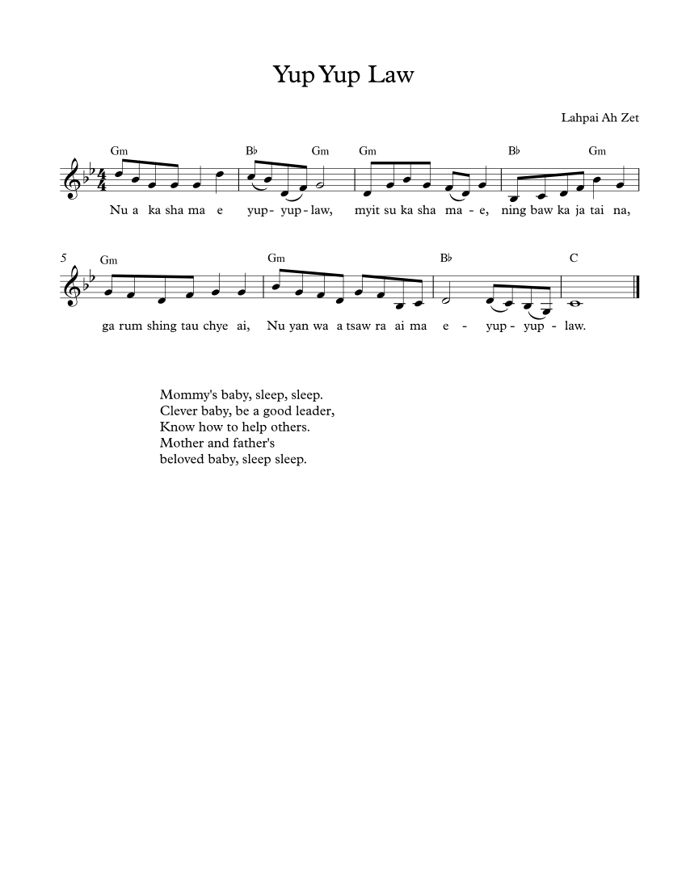

Slide 5
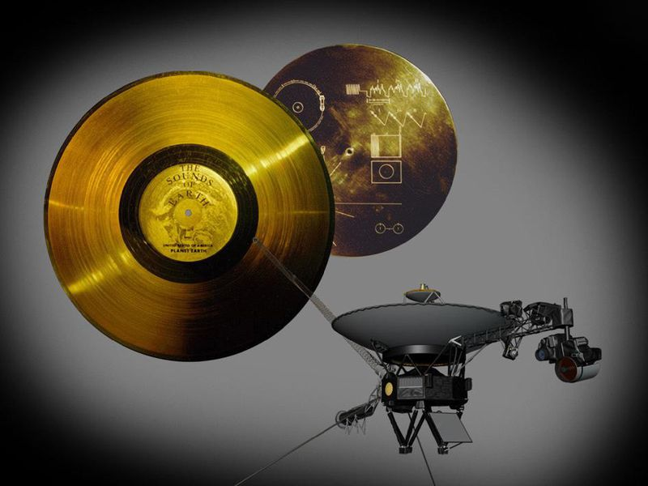

Slide 6
Stay Woke

Slide 7
"Words? Music? No: it's what's behind."
-James Joyce

Slide 10
ENSOULMENT
the singer and the song

