Slide 1
How to Fund Music Training in Southeast Asia in the 21st Century
Congress of SEADOM (Southeast Asian Director of Music)
March 23rd, 2013 @ Ho Chi Min Conservatory of Music
By Assoc. Prof. Dr. Sugree Charoensook
Dean of College of Music, Mahidol University, Thailand
Notes:
Dr. Somchai Trakarnrung

Slide 2
1. Hardware

Slide 3
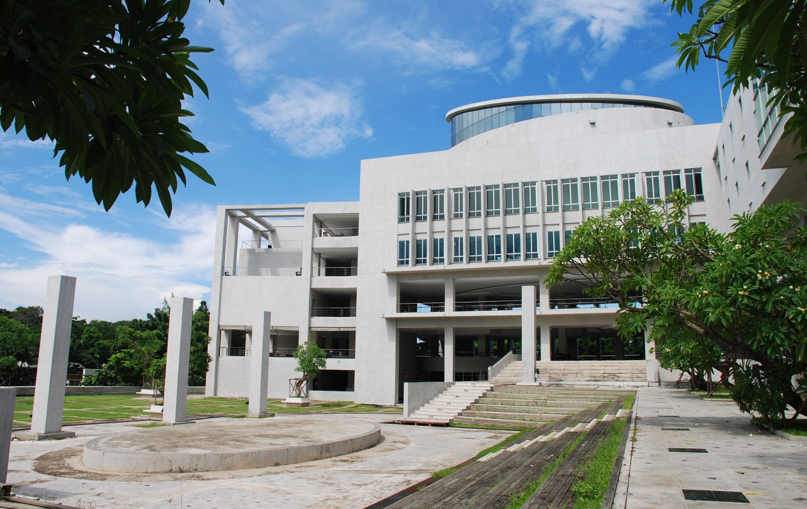
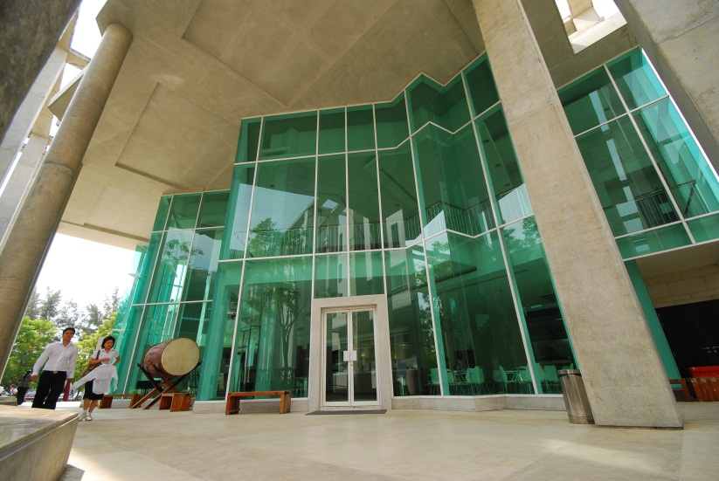
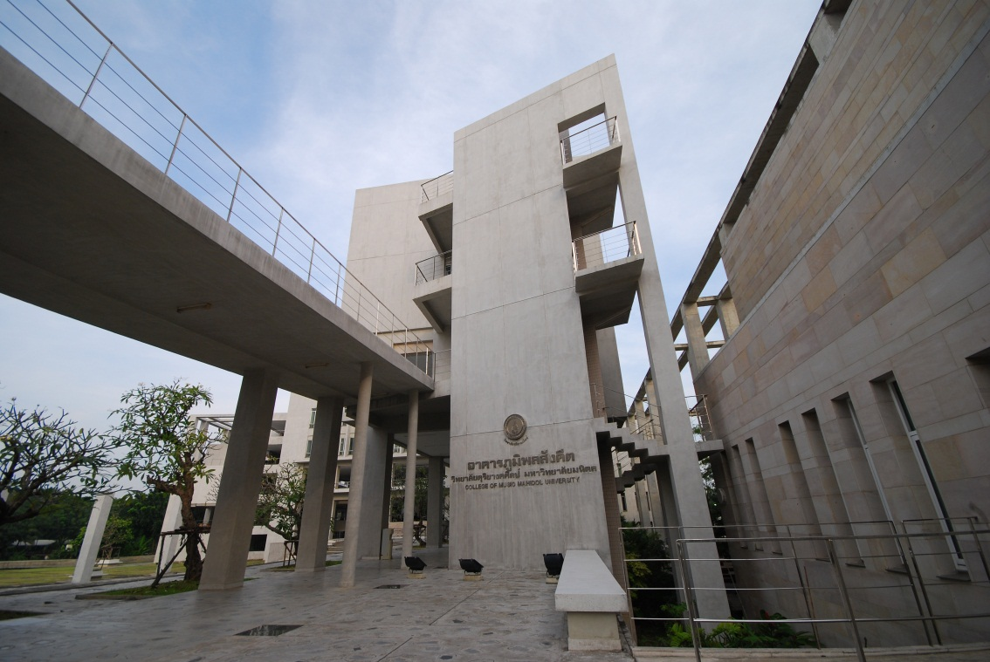
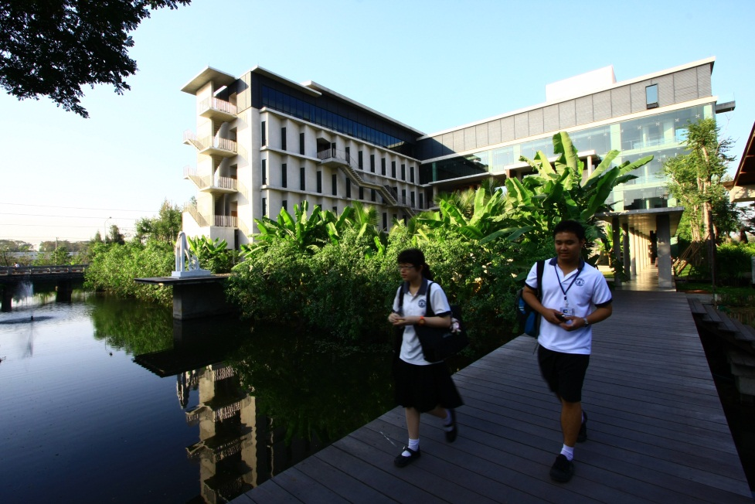
Buildings

Slide 4
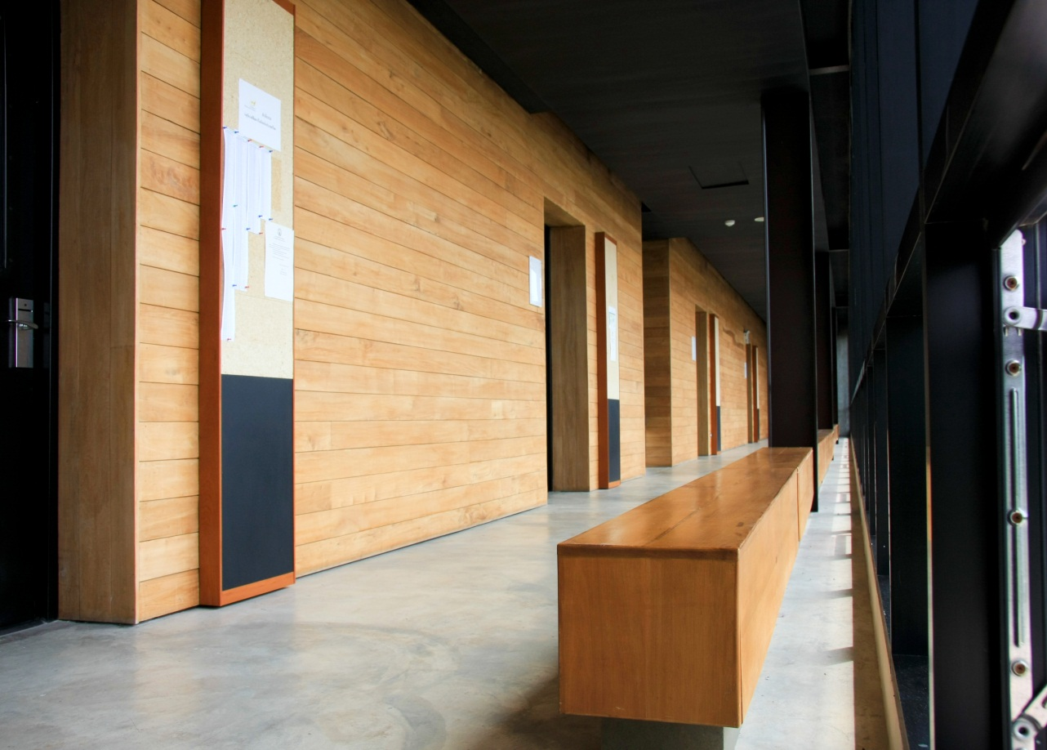
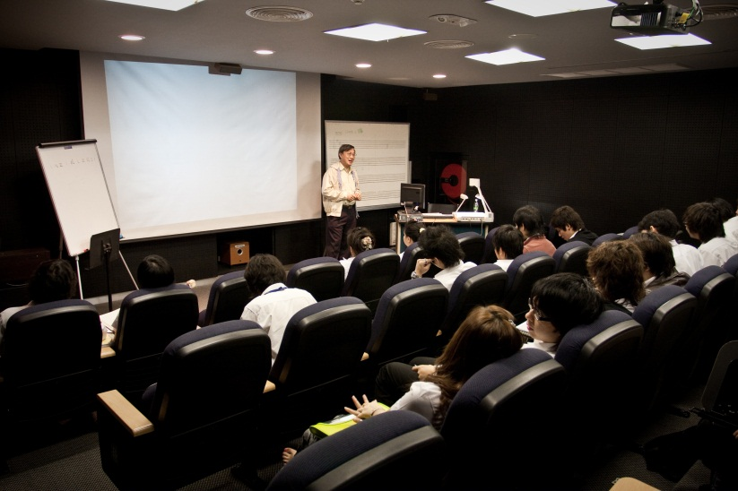
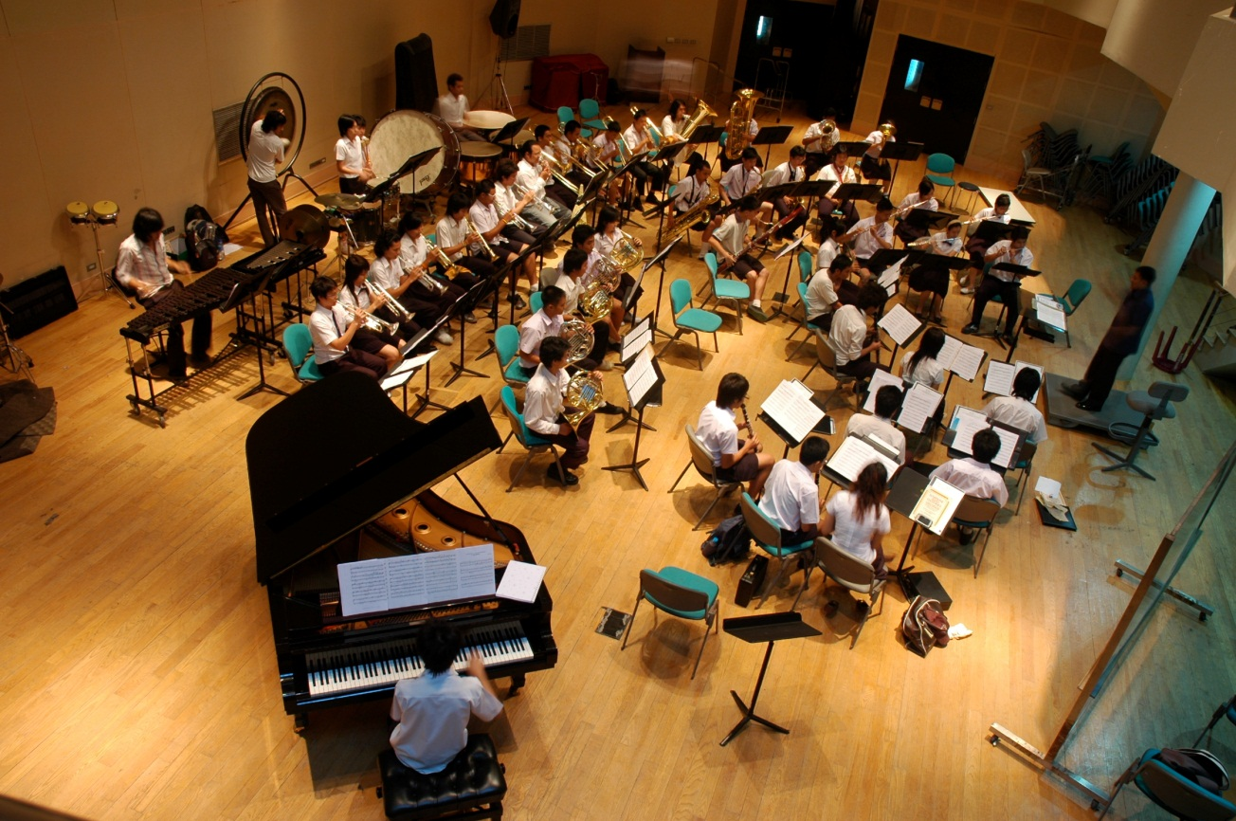
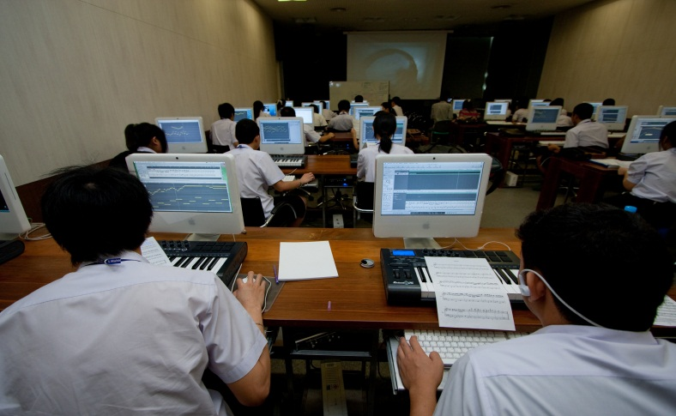
Music Classrooms

Slide 5
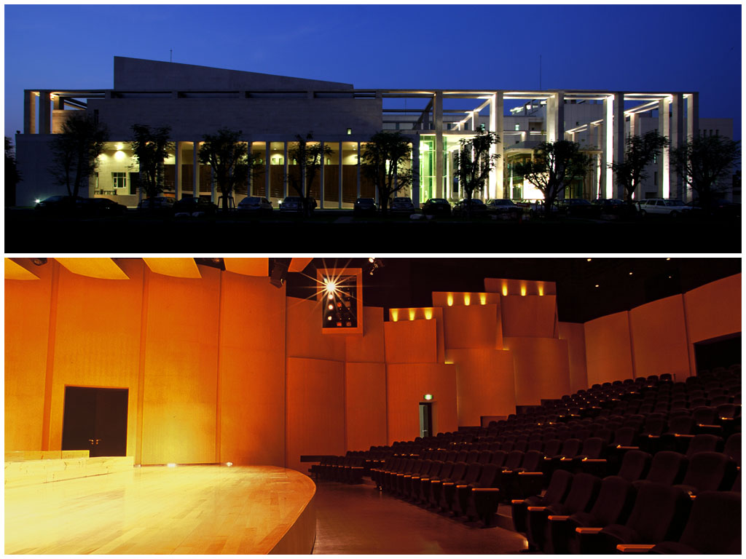
Concert Hall

Slide 6
2. Software

Slide 7
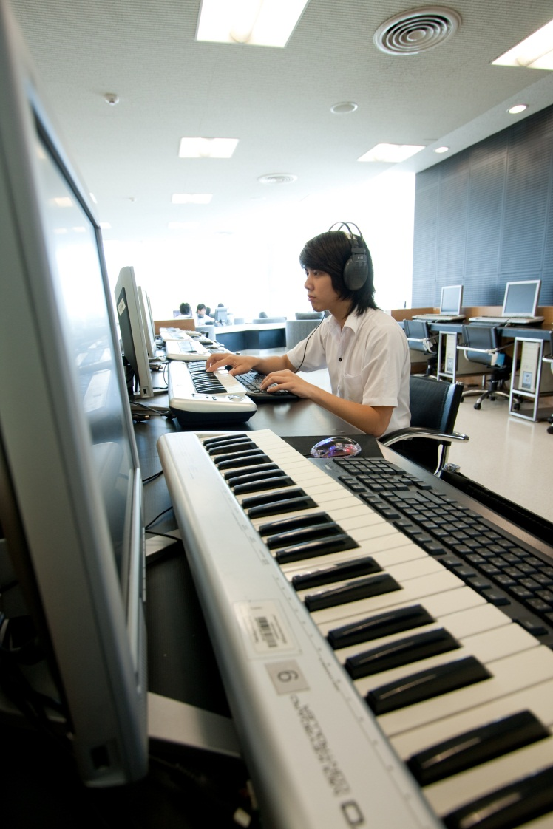
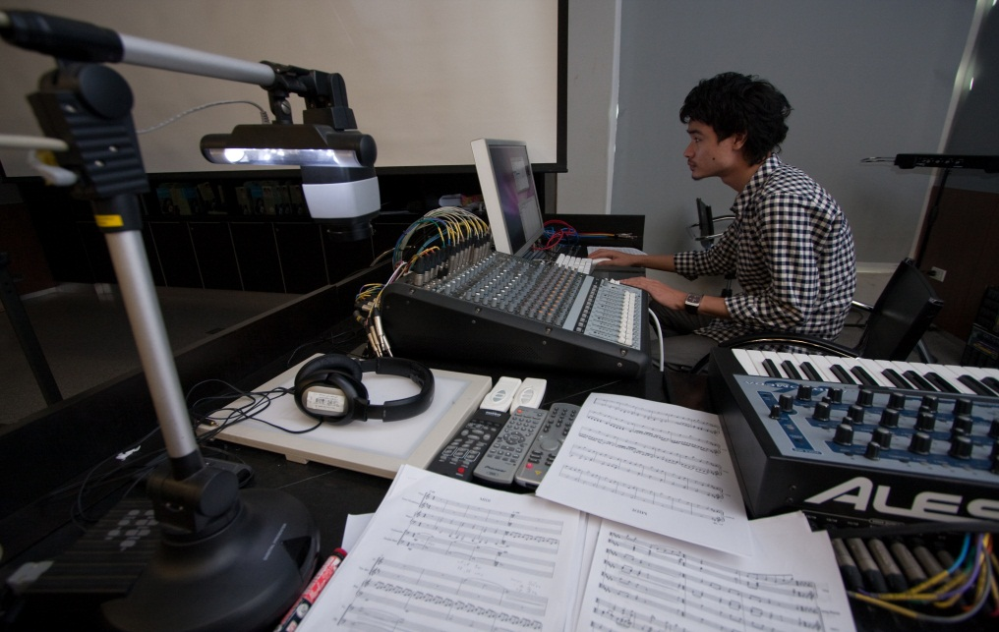
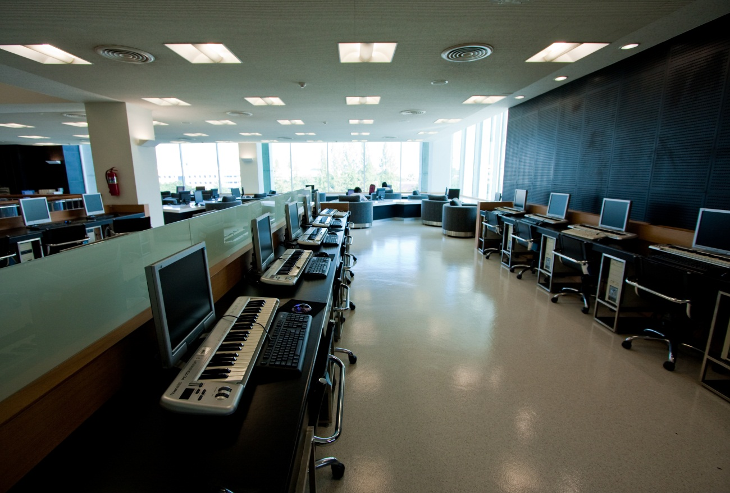
Computers

Slide 8
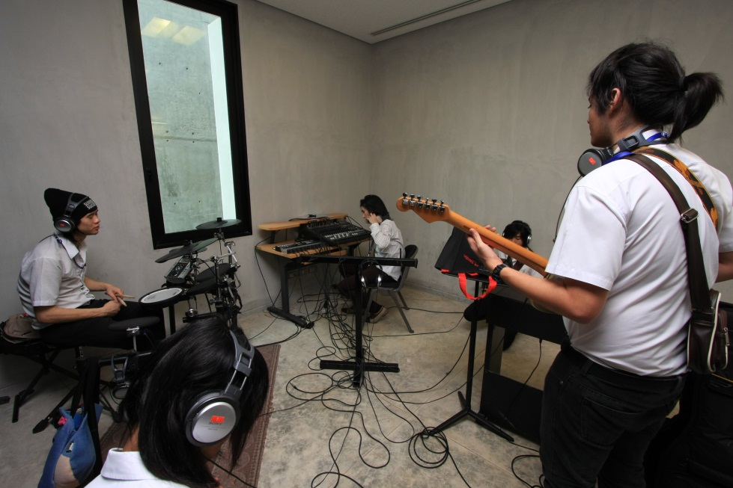
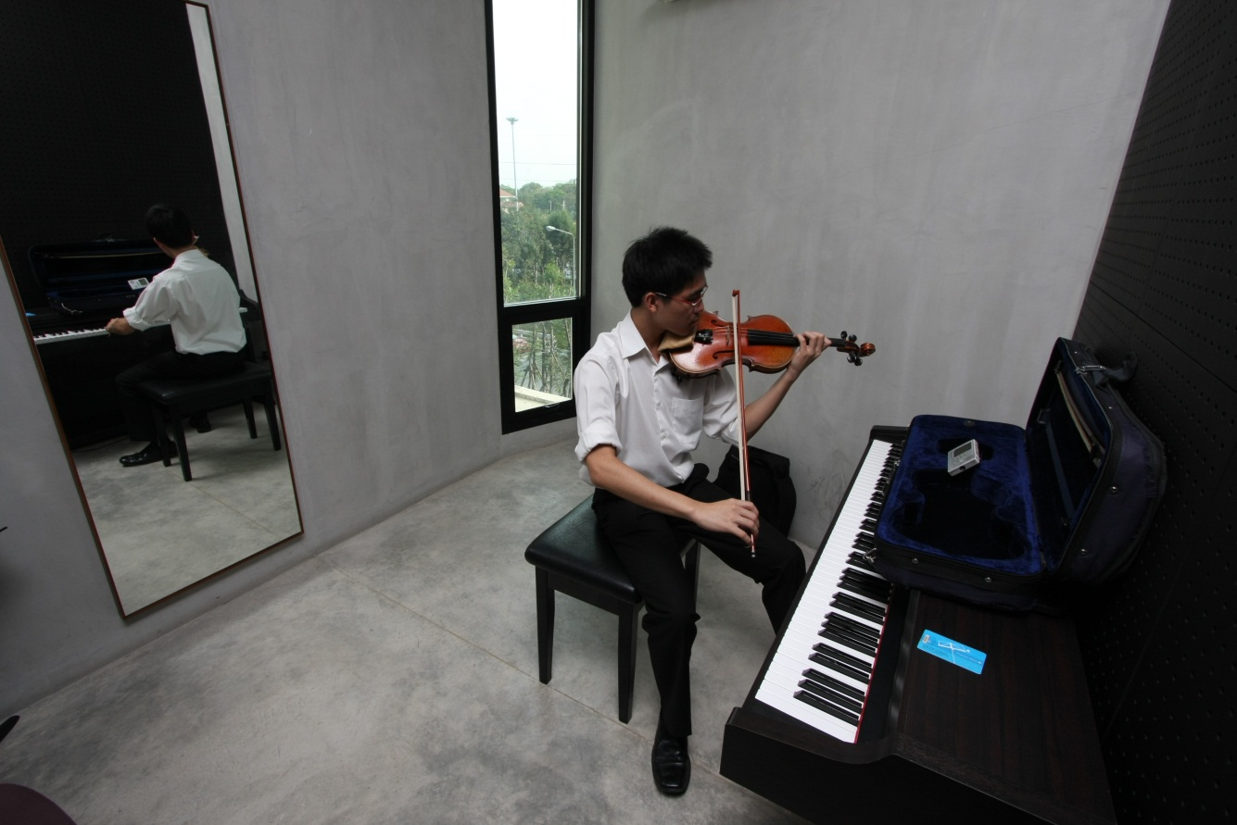
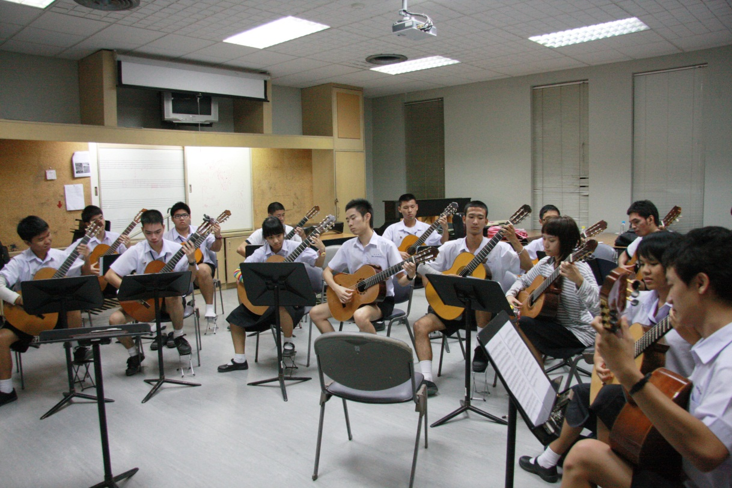
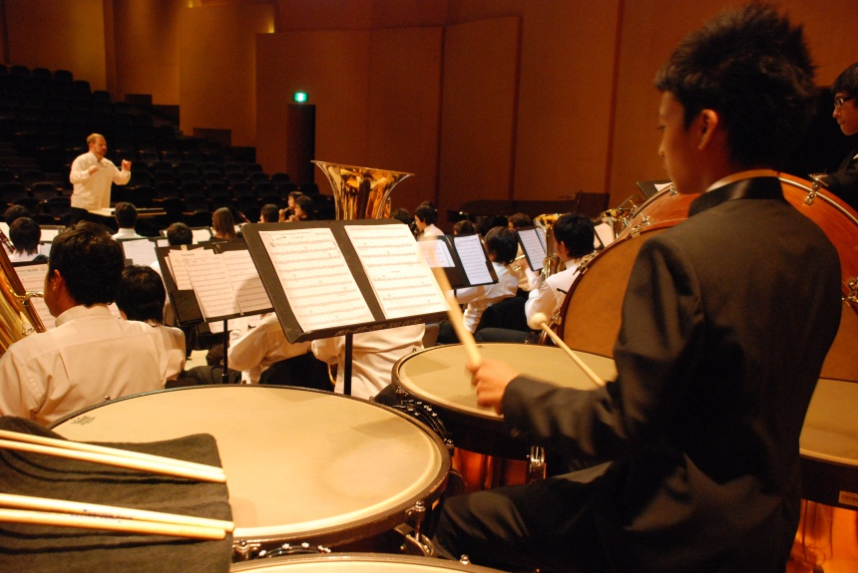
Music Instruments & Equipments

Slide 9
Curriculum
Young Artist Music Program
  Classical Music
  Jazz Music
  Thai Music
Bachelor of Music Program (B.M.)
  Classical Music Performance
  Jazz
  Popular Music
  Thai and Eastern Music
  Music Composition
  Musical Theatre
  Music Business
  Music Technology
  Music Education and Pedagogy
Master of Arts Program (Music) (M.A.)
  Musicology
  Music Education
  Music Business
  Music Therapy
Doctor of Philosophy Program (Music) (Ph.D.)
  Musicology
  Music Education
Master of Music Program (M.M.)(International)
  Music Performance and Pedagogy
  Music Composition and Theory
  Conducting
  Collaborative Piano
  Jazz
Doctor of Music Program (D.M.)(International)
  Music Performance and Pedagogy
  Music Composition and Theory
  Conducting

Slide 10


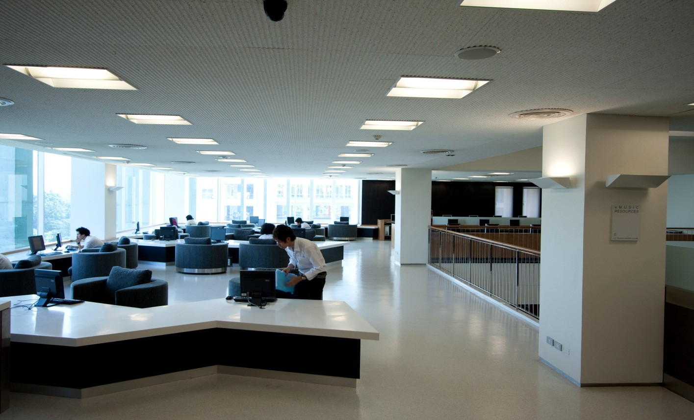
Books & Library

Slide 11
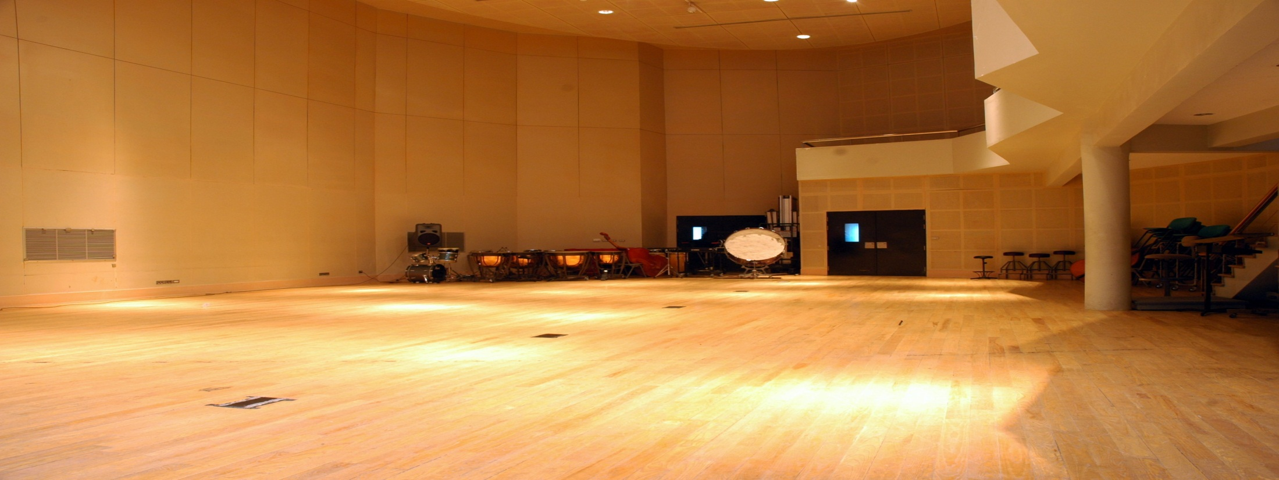
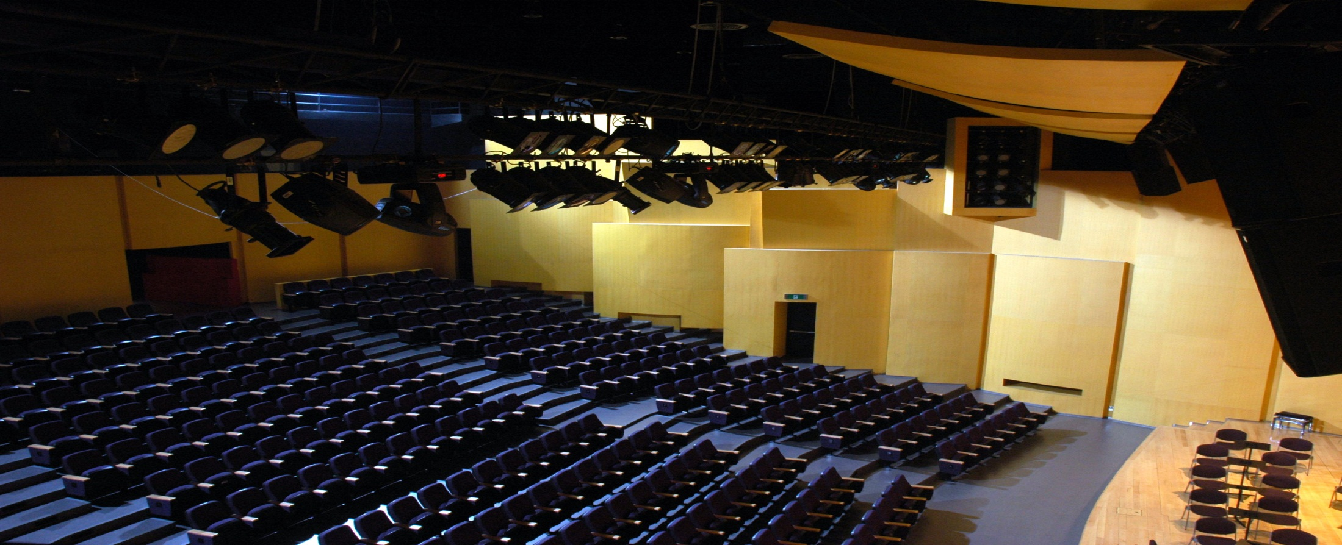
Rooms with Excellent Acoustic

Slide 12
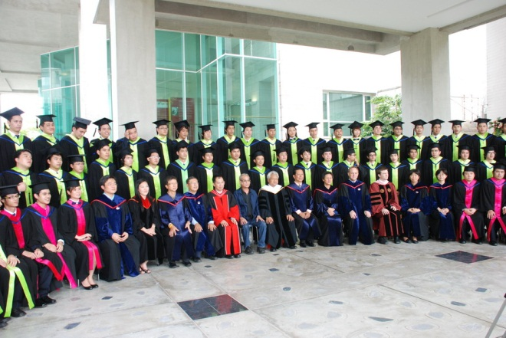
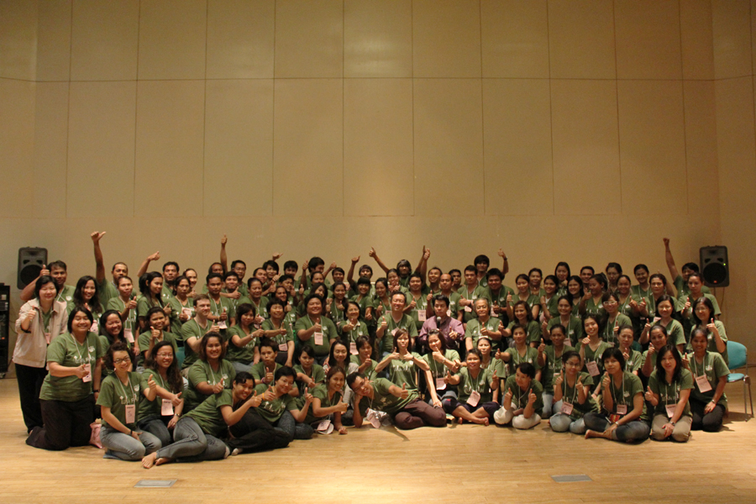
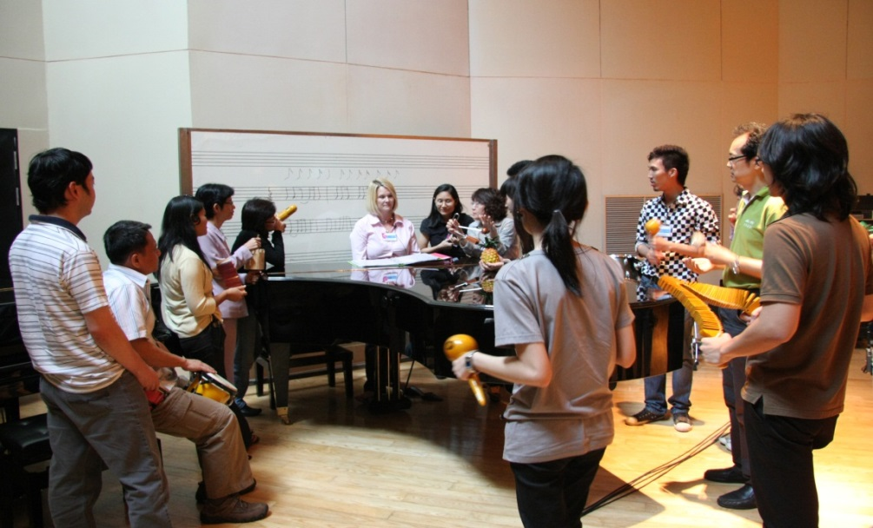
3. Peopleware

Slide 13
3. Peopleware
Visions
Direction
Decision
Connections
Relations/ Communication
Action
No Corruption

Slide 14
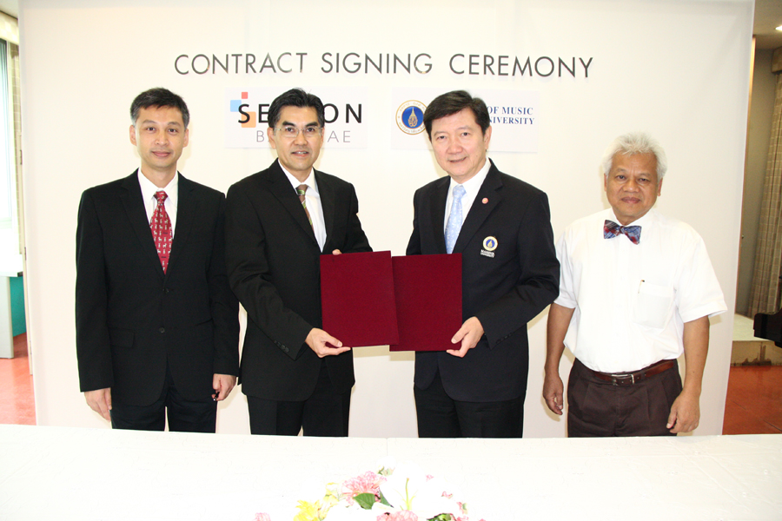

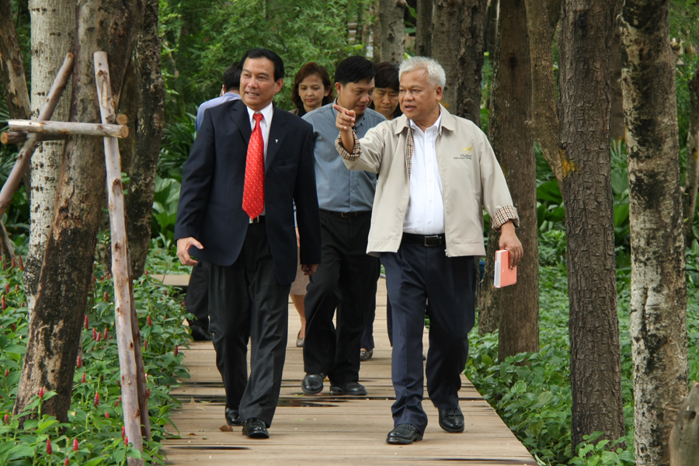
4. Moneyware
Tuition & Fee
Government Support
Private Sector Support
Donation

Slide 15
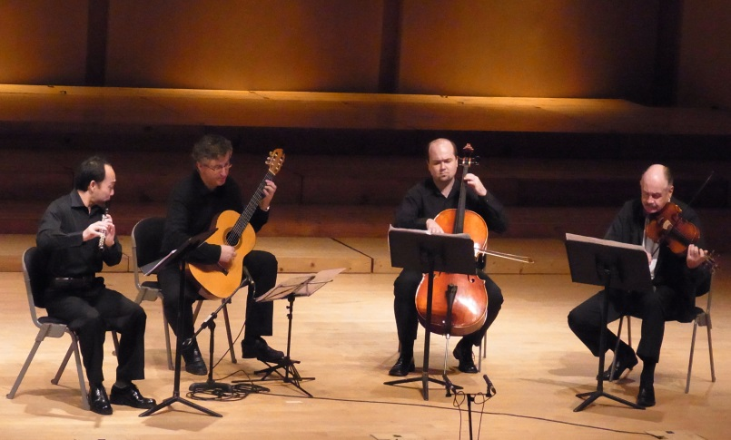
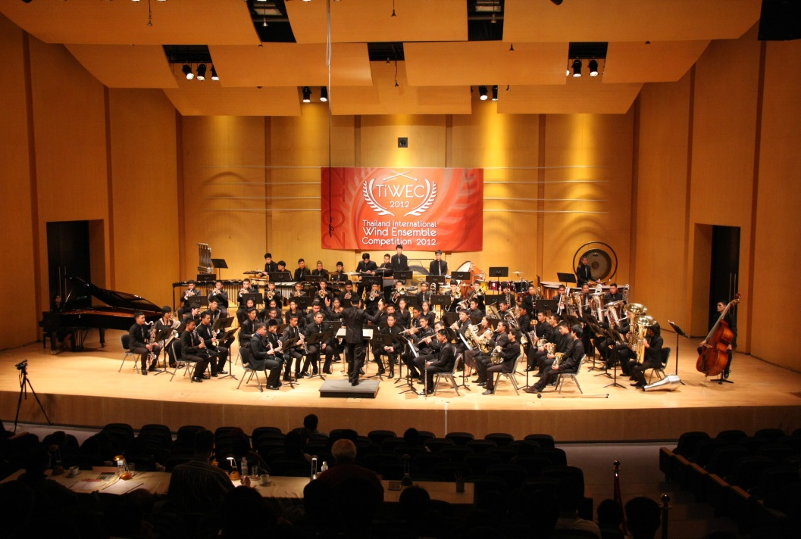
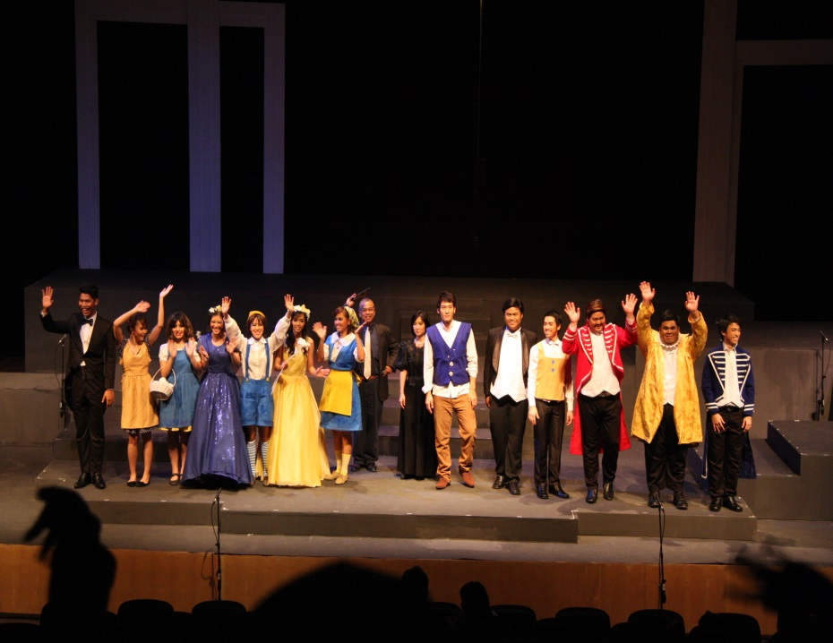
5. Qualityware
Quality comes first
Standard is no compromise!

Slide 16


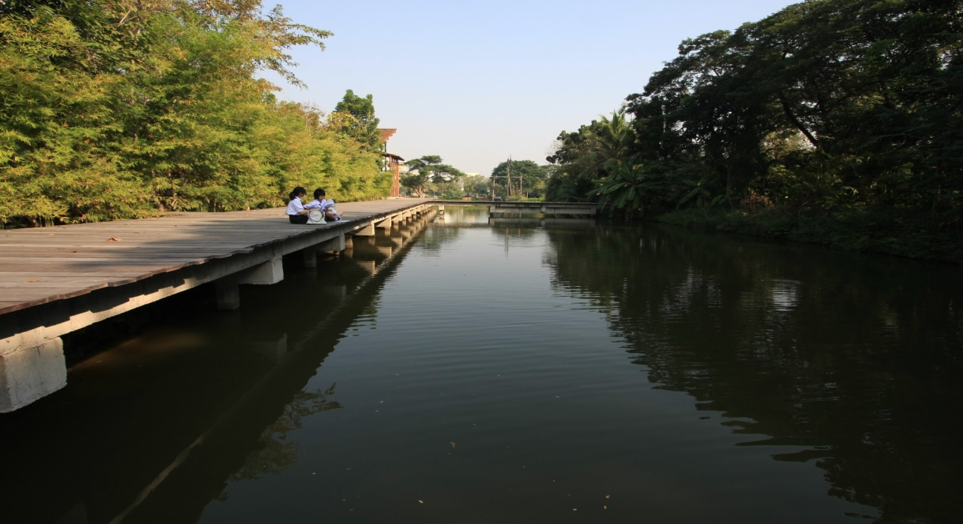
6. Spiritualware
Identity
Culture
Taste

Slide 17
For “Students”

