Slide 1
Welcome to SEADOM!
Inspiring fresh evolution
Bernard Lanskey
Vientiane, LAO
24th March 2016

Slide 2
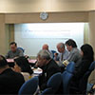

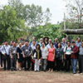
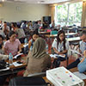
Background
The story so far
Framing the organisation: Themes and focal points:
      Leadership, Communication & Advocacy / Quality in Learning & Teaching / Research & Critical Reflection / Southeast Asian Music Traditions / Professional Development & Community Engagement / Student & Staff Opportunities / Celebrating the New
      National considerations of regional themes
  This Congress – the Lao Context
Notes:
2008… NASM / AEC / NACHTMUS / AEC...Thailand, Singapore, Malaysia, Vietnam, Philippines, Laos (Indonesia, Brunei, Cambodia, Myanmar, - ambition to represent all professional musical educational pathways (not just the western oriented or the formal)…Registered in Thailand in 2015…seeking ASEAN registration…
Advocacy New programmes, schools and directions…… Specific presentations to tease out principal themes

Slide 3
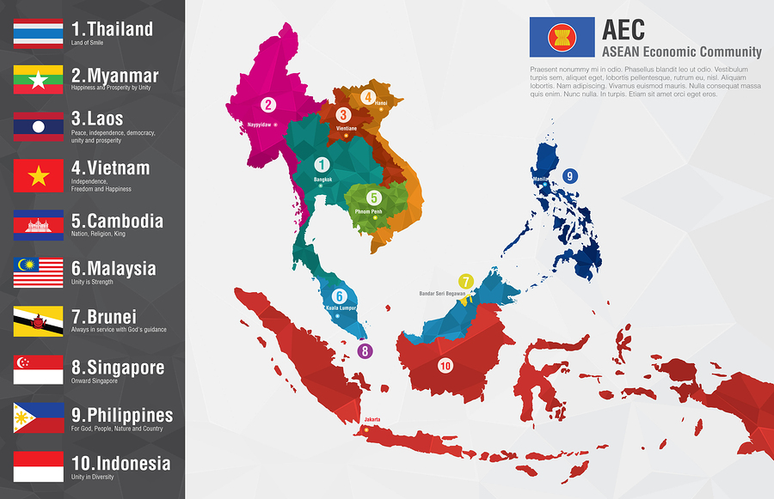
Building a region
‘The ASEAN Way’: Compromise, Consultation, Consensus
Connecting and communicating: transcending difference, advocating inclusivity
Being heard authentically
Responding to the upbeat

Slide 4
Leading evolution continues now –
To a fruitful 2016 congress and beyond!

