Slide 1

SEADOM 2016
General Assembly
Vientiane, Laos
25 March 2016

Slide 2
Welcome
Attendance sheet
82nd official AGM
Not an election year
Agenda for AGM
SEADOM Membership

Slide 3
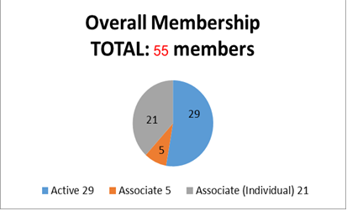
1. Overall Membership: 55 Members from 17 Countries

Slide 4
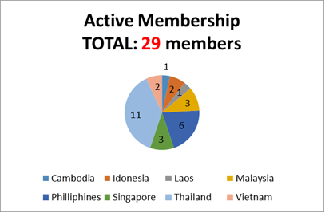
2. Active Membership: 29 members from 8 Countries

Slide 5
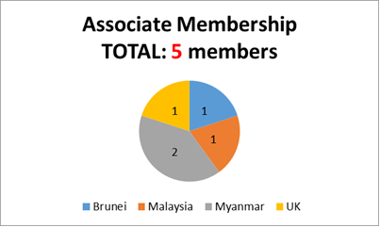
3. Associate Membership: 5 members from 4 Countries

Slide 6
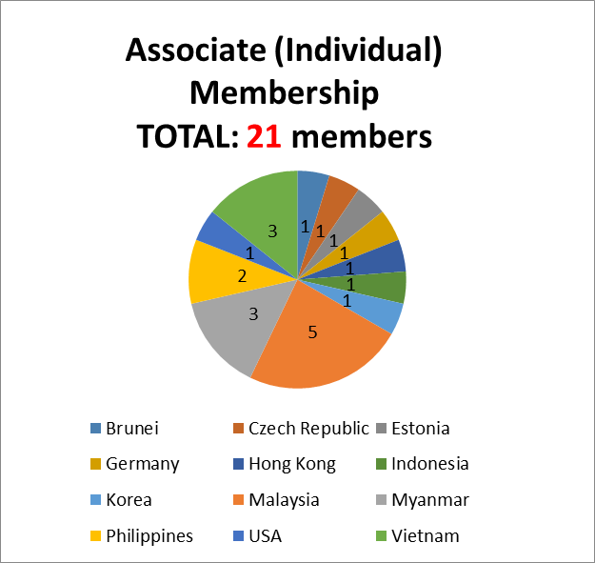
4. Associate (Individual) Membership:
21 members from 12 Countries

Slide 7
5. New SEADOM Members (MBS Year 2016): 8 members from 5 countries
New SEADOM Members (2016)
No. | Type | Country |  | Institution
1 | Active | Thailand | 1 | College of Music, Mahasarakham University
 |  | Thailand | 2 | Faculty of humanities and social sciences, Nakhon Si Thammarat Rajabhat University
 |  | Thailand | 3 | Faculty of Fine Arts, Songkhla Rajabhat University
Total 4
2 | Associate | Myanmar | 1 | ILBC
Total 1
3 | Associate (individual) | Malaysia | 1 | Cheong Ku Wing University of Malaya
 |  | USA | 2 | Stephen Luttmann
 |  | Germany | 3 | David Fruehwirth
 |  | Myanmar | 4 | Soe Thura Win
Total 4

Slide 8
Participation at SEADOM 2016
Thailand 45
Laos 39
Malaysia 13
Singapore 10
Vietnam 4
Myanmar 2
1 each from Brunei, Cambodia, Japan, Norway, Switzerland, Germany, USA, Iceland
Total 121 pax

Slide 9
Apologies
Vice President Associate Professor Dr Sugree Charoensook
EXCO Prof Jose Buenconsejo
National Representative (Malaysia)
Hasnizam Wahid

