Slide 1

Toward a cultures-aware music education
Xavier Bouvier
Geneva Haute école de musique, Switzerland

Slide 2
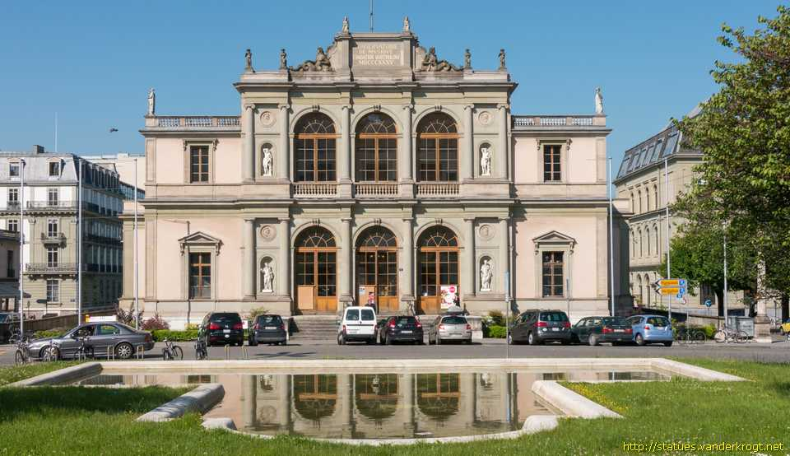

Slide 3


Slide 4
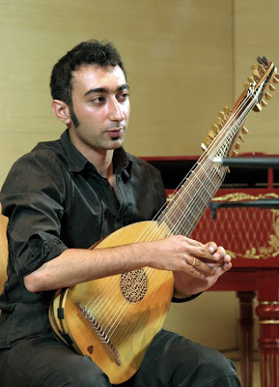

Slide 5
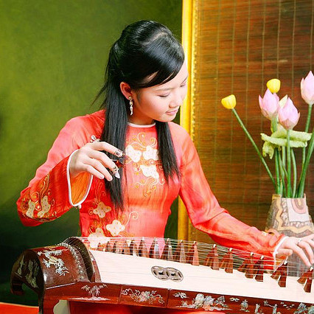

Slide 6
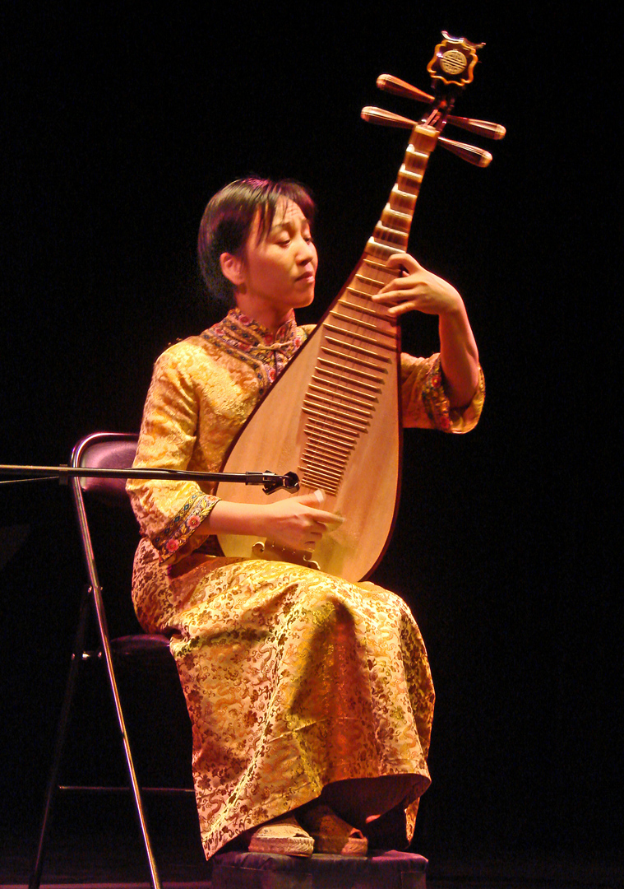

Slide 7


Slide 8
Be yourself, have your own vision, your own hearing
Beware normativity
Reflect about and deal with diverse modes of transmission
Reflect about and deal with distinct relations to tradition
Explore what is going on at the frontiers between cultures
Prefer non centralized networking / south-south exchanges
Be prepared for the corrosive effects of dealing with cultures

Slide 9
Thank you for your attention !

