Slide 1
SC800
Marketing Guide
By: Product Management Department
Date: 28th Nov.

Slide 2

CONTENT
01
Why new terminal?
02
Product Introduction
Product/Place/Promotion
03
Comparison and positioning
04
Launching plan

Slide 3

Why new terminal?
New generation RFID A&C Terminal
Multiple RFID

Slide 4
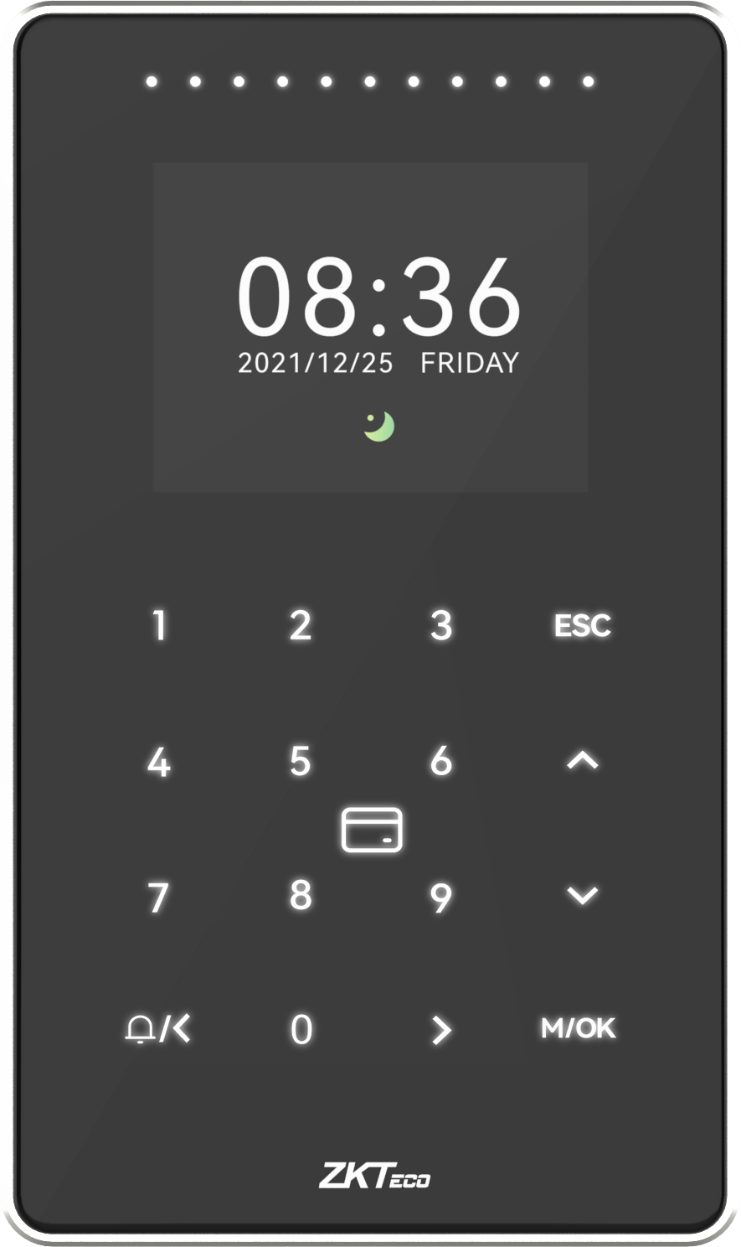
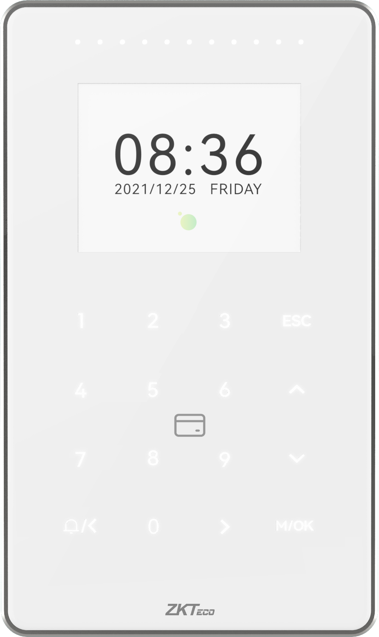
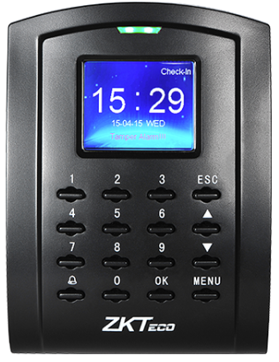
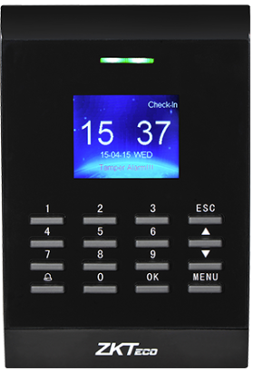
New generation RFID A&C Terminal
SC105
SC405
SC800
Multi-Tec RFID Outdoor IP65,IK04

Slide 5
Product
Introduction
Product
Place
Promotion

Slide 6
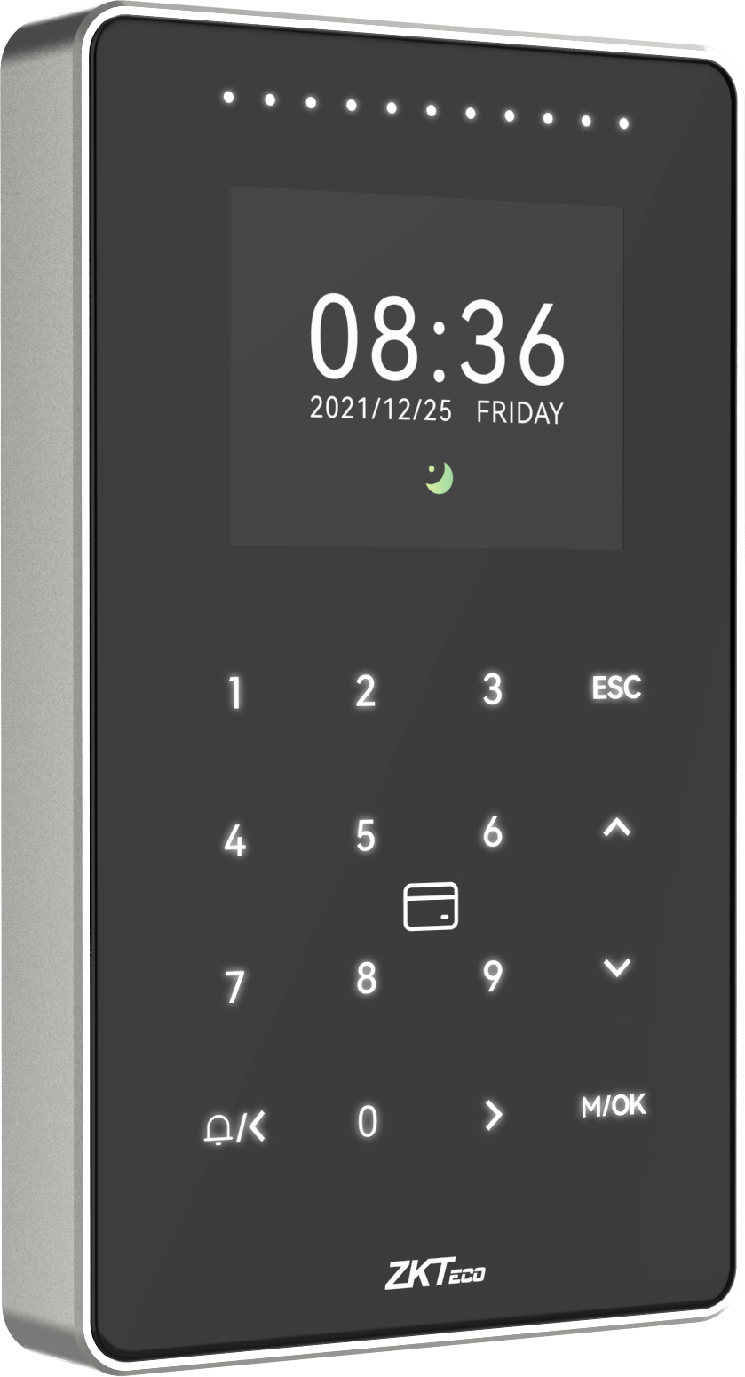
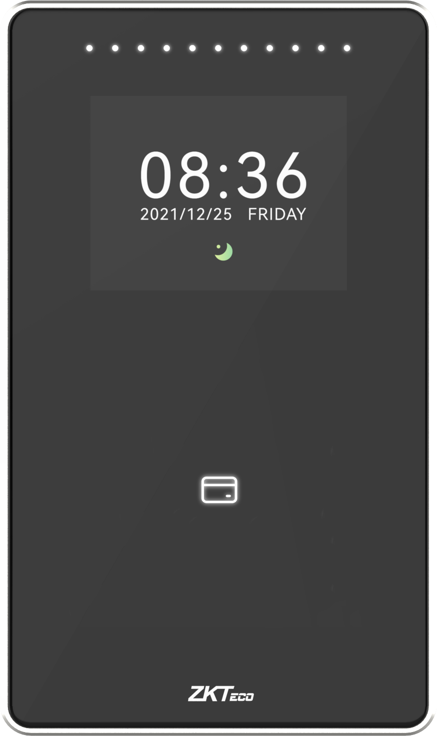
Product
Breathing light: White, Status light: Red/Green
Standby Break Screen
Hidden Touch Keypad
Aluminum alloy frame
SC800

Slide 7
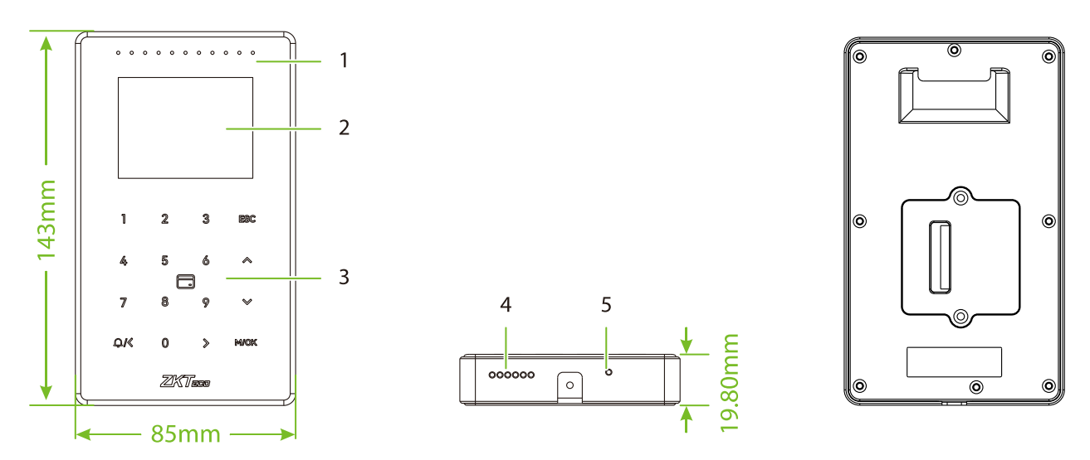
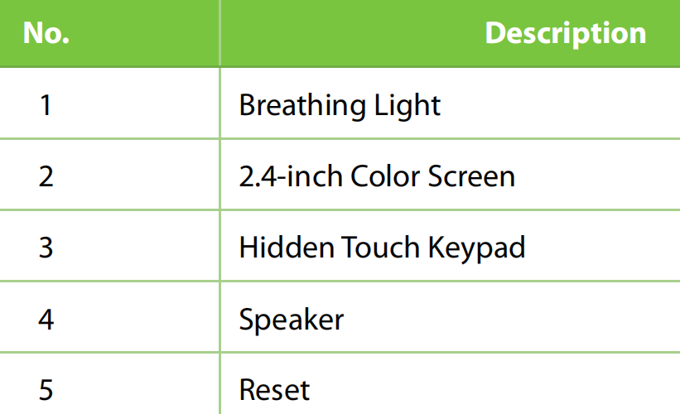
SC800 is a RFID only access control device, supports single frequency and multi-frequency RFID modules, card types include: EM card, IC card, HID Proxy, HID iclass, etc..
mold structure design support IP65 waterproof and IK04 anti-collision.
Firmware support A&C push and T&A push, can be connected to ZKBioAccess IVS software or ZKBioTime8.0 software, can be applied to access control management and attendance time management.

Slide 8
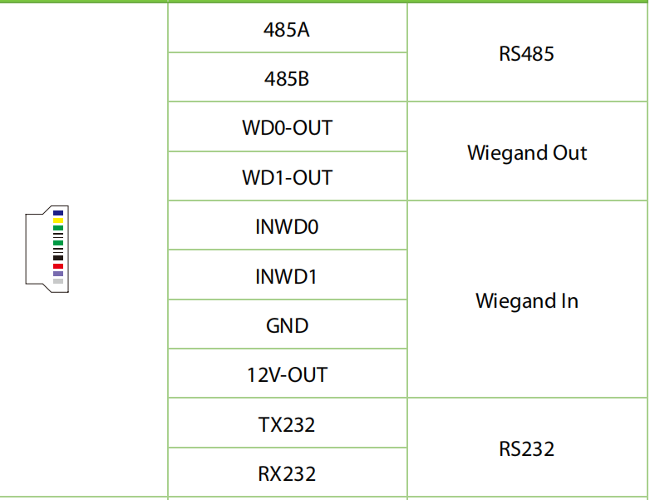
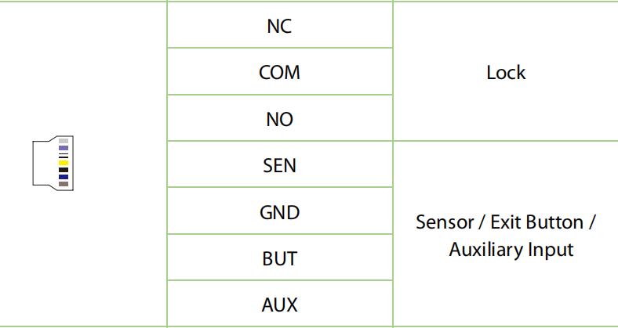
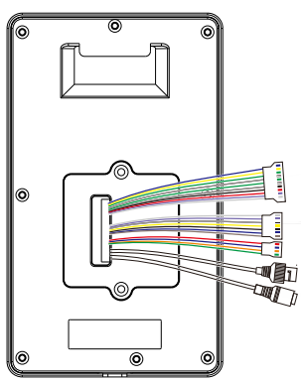
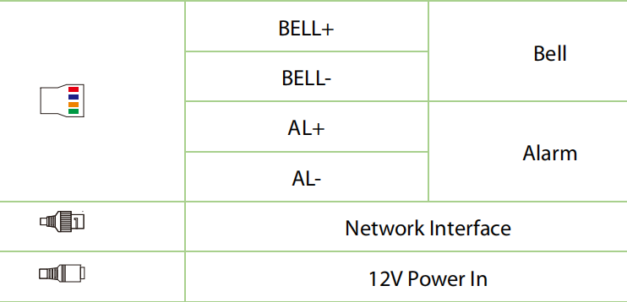
Terminal Description

Slide 9
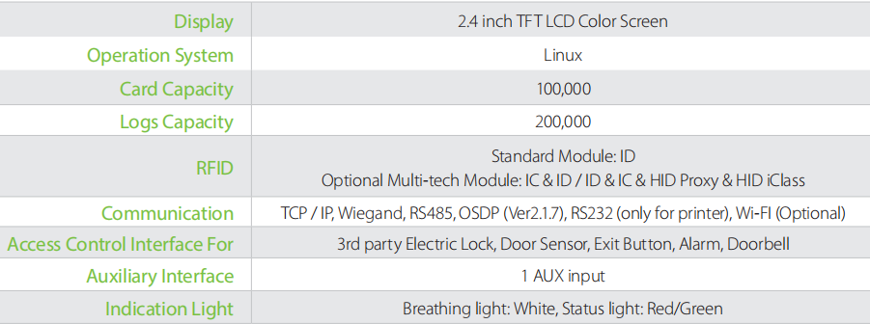
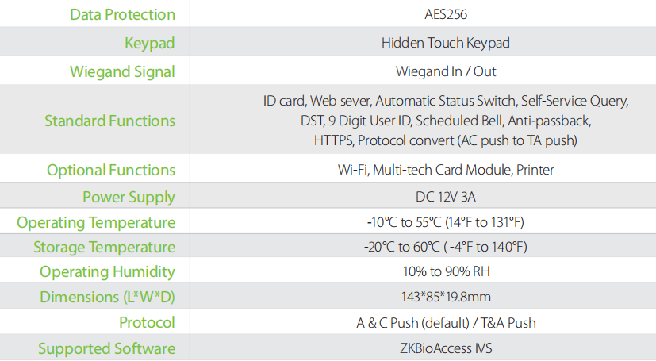
Specifications

Slide 10
Features
IP level | IP65
IK level | IK04
Multiple RFID | up to 100+ card types (including, ID / IC / Legic / DESfire EV1 / EV2 / HID Prox. /HID iClass / etc.
Communication Https Encryption | Supported
PUSH Protocol | Support Access Control push conversion to Time Attendance push
Communication | TCP/IP, Wi-FI (Optional), Wiegand in&out, RS485, OSDP (Coming soon), RS232 (for printer)
Working Temperature | -10°C ~ 55°C ( 14°F~ 131°F)
Storage Temperature | -20°C ~ 60°C ( -4°F~ 140°F)
web server | Supported
Work Model | Standalone (defaut)/ Reader(Coming soon)

Slide 11
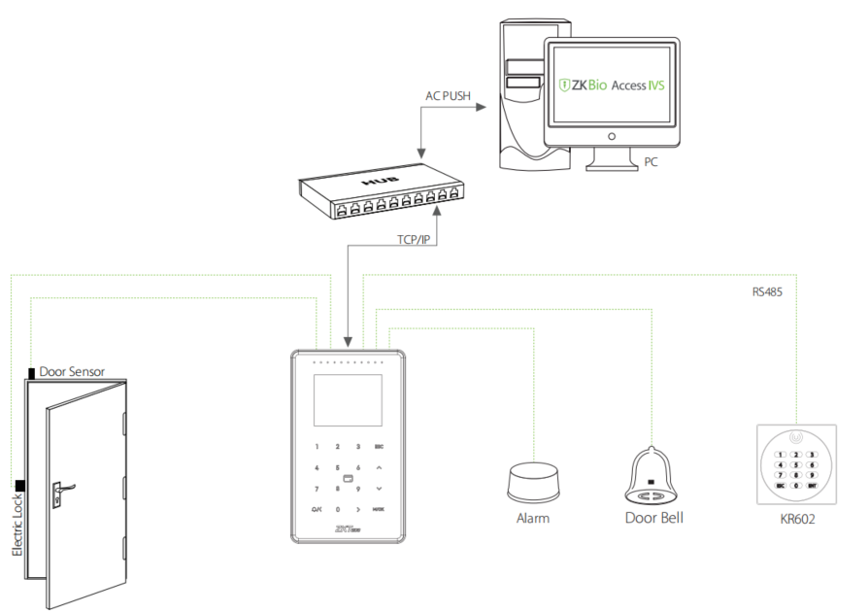
Compatible with ZKBioAccess IVS

Slide 12
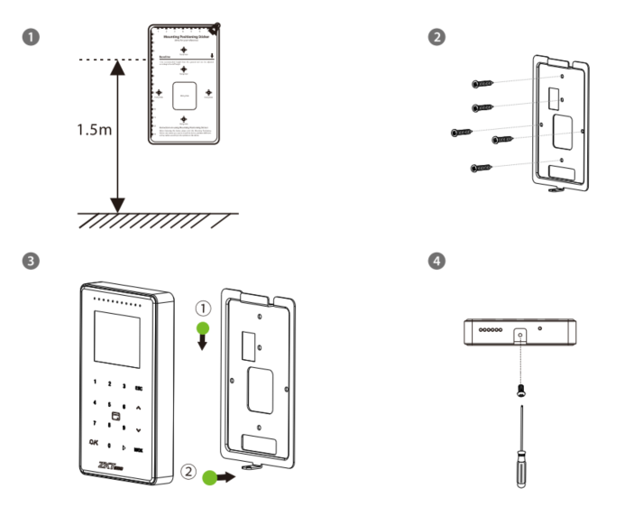
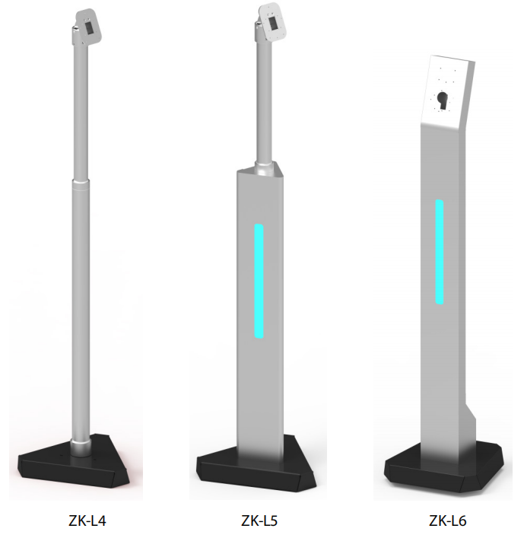
Installation Place
Wall Mount compatible with Asia-Gang box（Mounting pitch：60mm）
Compatible with floor stand mounting

Slide 13


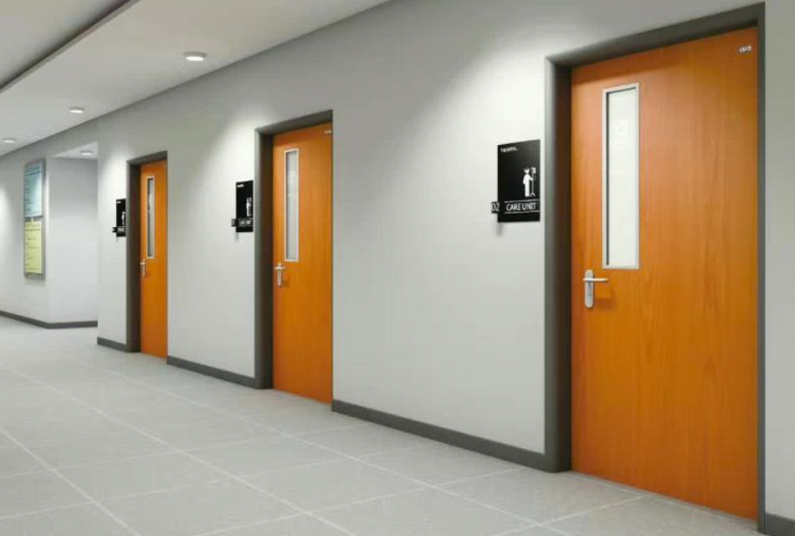

Installation Environment
indoor
Semi-outdoor or outdoor light rain
IP65 waterproof
For outdoor Heavy rain，Should IP66 device;
Suggest：ProRF(Only RFID), ProMA Series

Slide 14


Promotion-1
Choose RFID SC800
RFID tag reading is efficient and fast
RFID authentication has strong traceability with no retrieval of users’ biometrics data

Slide 15
Promotion-2
Muliple RFID or HID card requirement can choose SC800
SC800[B133]:ID&IC&IC EV1
SC800[MTR30-P]:ID&IC&IC EV1&HID Proxy
SC800[M356i]:ID&IC&IC EV1&HID Proxy&HID iclass
(coming soon)
SC800
Multi-Tec RFID Module

Slide 16

Comparison and positioning
Will you win the game?

Slide 17

Positioning
RFID A&C Terminal
Grading
Channel/System integrators
Upgrade
IP65/IK04, Multiple RFID,WIFI
y
x
z
Chanel terminal
Price

Slide 18
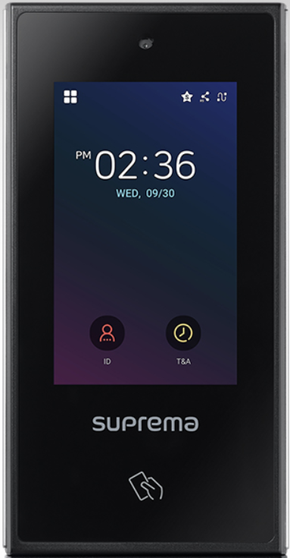
Product model | SC800 | XStation
Photo
Display | 2.4-inch Non-touchless | 4.0-inch Touch
Biometric | NA | Fingerprint(Optional;)
RFID | 125 kHz EM, HID Prox & 13.56 MHz MIFARE, MIFARE Plus,DESFire EV1/EV2(1), FeliCa, iCLASS SE/SR/Seos | 125 kHz EM, HID Prox & 13.56 MHz MIFARE, MIFARE Plus,DESFire EV1/EV2(1), FeliCa, iCLASS SE/SR/Seos
Protect Level | IP65,IK04 | IP65
Card Capacity | 100,000 (Support Expansion:500,000) | 500,000
Logs Capacity | 200,000 | 5,000,000
Communication | TCP/IP,WIFI(Optional),Wiegand in/Out/RS485,POE(external) | TCP/IP,WIFI,Wiegand in/Out,RS485(OSDP),POE
Operation System | Linux
Working Temperature | —20℃ ~55℃ | —20℃ ~50℃
Dimensions (W*H*D) | 85*143*19.8mm | 82*159*25.9 mm
Supported Softwares | ZKBioAccess IVS | Biostart 2/Biostart 2 Mobiel
Carmera | NA | CMOS 2M pixels / 1600 x 1200
Mobile Access | Coming Soon | NFC/BLE
Certification | CE FCC UKCA RoHS | KC, CE, UKCA, FCC, RCM (Compliance: RoHS, REACH, WEEE)
SC800 Economical

Slide 19
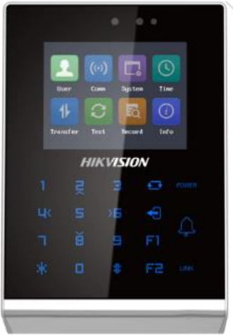
Product model | SC800 | DS-K1T105AE
Photo
Display | 2.4 inch Non-touchless | 2.8 inch LCD
Keypad | Hidden touch keypad | Touch keypad
RFID | 125 kHz EM, HID Prox & 13.56 MHz IC,IC Plus,DESFire EV1/EV2(1), FeliCa, iCLASS SE/SR/Seos | 125 kHz EM, 13.56 MHz IC,
Protect Level | IP65,IK04 | IP65
Card Capacity | 100,000 | 100,000, MAX.300,000
Logs Capacity | 200,000 | 3,000,000
Communication | TCP/IP,WIFI(Optional),Wiegand in/Out/RS485 | TCP/IP,WIFI,Wiegand,RS485
Wiegand Format | 26/34 ,support Self defined format | 26/34
Operation System | Linux | Linux
Working Temperature | —20℃ ~55℃ | —30℃ ~60℃
Dimensions (W*H*D) | 85*143*19.8mm | 137*142*35 mm
Supported Softwares | ZKBioAccess IVS | HikCentral Access Control 2.0
Mobile Access | Coming Soon | N/A
Certification | CE FCC UKCA RoHS
SC800 Simplicity Design With Multi-tech,More Powerful than H.

Slide 20

Launching plan
Launch Schedule

Slide 21
Previous
HD Photo， Quick start guide， User manual -- Done
1. 2022.12.5 SC800 Acceppting Order
2. 2022.12. 10 Marketing document release
3. 2022.12.15 Launch on the web-site
4. 2022.12.31 CE, FCC ,IP66,IK07,Sea and Air Transport Certification

Slide 22
THANK FOR YOUR ATTENTION
By: Jack Date: 20th-May.

